Slide 1
Social Context of Computing

Slide 2
Learning Objectives
Interpret the social context of a particular software/hardware implementation
Computing tool implementation
Positive and negative ways in computing
Why computing/network access is restricted in some countries
Impact of the digital divide
Understand how income, geography, race, and culture influence access to information technology and technology in general
Identify how internet has changed the face of computing and it has affected society

Slide 3
Young and aggressive, Johnny has a promising future as a business. Johnny is on track to reach a million dollars before the age of 25 thanks to several successful businesses and a few start-ups with promising financial standing.
Johnny's business talks are basically in difficult areas. Because of this, Johnny employs a group of trained security bodyguards to follow him nearly 24 hours a day so that he can feel safe. A constant stream of visitors, including both friends and business partners, visit Johnny in his expansive $10 million house. Along with protecting him, his bodyguards also ensure that visitors are welcomed and escorted out of the venue in an orderly manner.
As a result, the bodyguards maintain a constant office and sleeping accommodations at Johnny's mansion. Johnny equipped the guards' offices and sleeping accommodations with cameras and listening devices without telling them in order to record every conversation and movement. He is secure in that manner!

Slide 4
1. Is Johnny violating any law ?
2. Do the bodyguards have any right to privacy on Johnny ’ s premises ?
3. Does Johnny have a right to know what the bodyguards are doing in their private quarters?

Slide 5
Introduction
Our focus in this chapter is on both the social and ethical effects of computer technology on people, whether we are at home, school, or work. We will focus on the social and economic dimensions of computing as a result of the “digital divide,” the workplace, workplace monitoring of employees, and the well-being of employees.

Slide 6
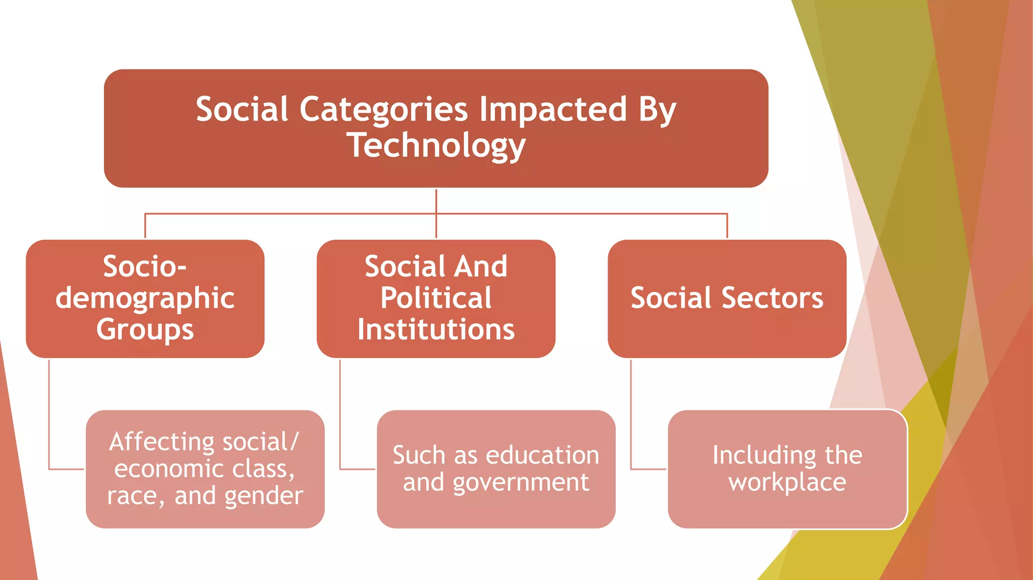
https://www.slideshare.net/UpekhaVandebona/social-context-of-computing

Slide 7
Digital Divide
The digital divide is a term that refers to the gap between demographics and regions that have access to modern information and communications technology (ICT), and those that don't or have restricted access. This technology can include the telephone, television, personal computers and internet connectivity.
In general, the study of the digital divide involves the study of the impact of the digital divide indicators. These indicators concern communication technologies such as radio, television, the press, fixed and cellular telephones, fax machines, computers, and connectivity to the Internet and participation in cyber activities for all members of a society.

Slide 8
5 indicators of Digital Divide
Access
Relevant technology
Human ware ( human capacity )
Infrastructure
Enabling environment .

Slide 9
Access
Access is a crucial component in the digital divide. It involves obstacles that exist even if all the other remaining indicators are in place.
These obstacles can broadly be grouped into five categories:
Geography
Income
Ethnicity
Age and
Education.

Slide 10
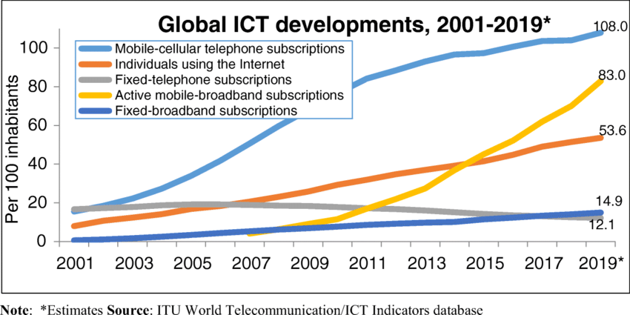
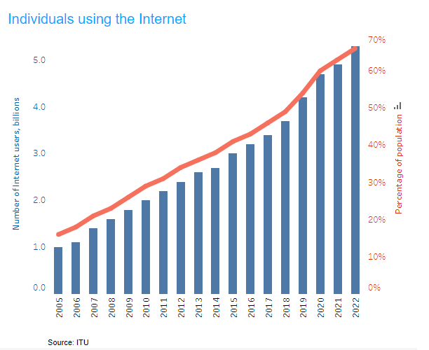

Slide 11
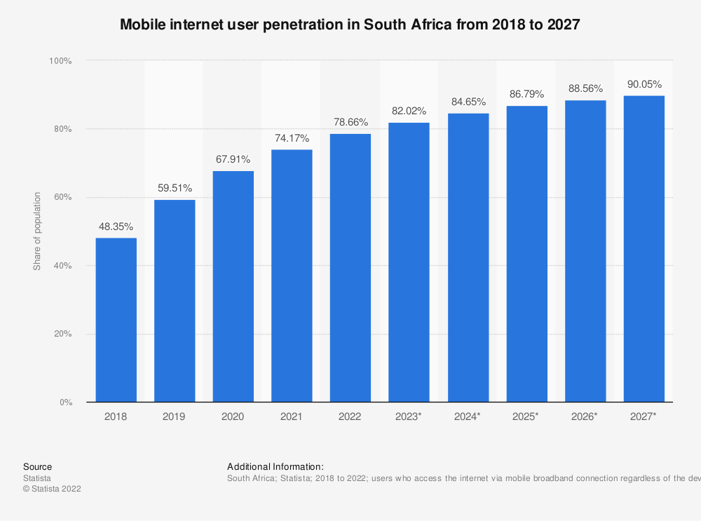
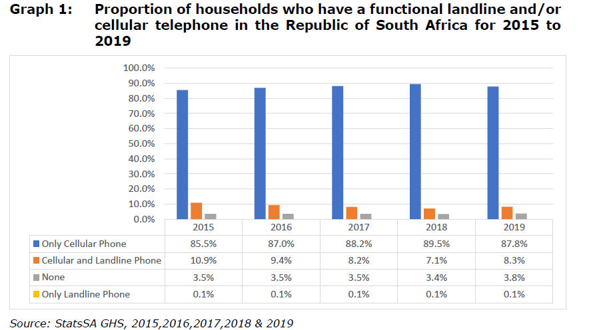
https://www.statista.com/statistics/972866/south-africa-mobile-internet-penetration/
The State of the ICT Sector Report in South Africa 2021

Slide 12
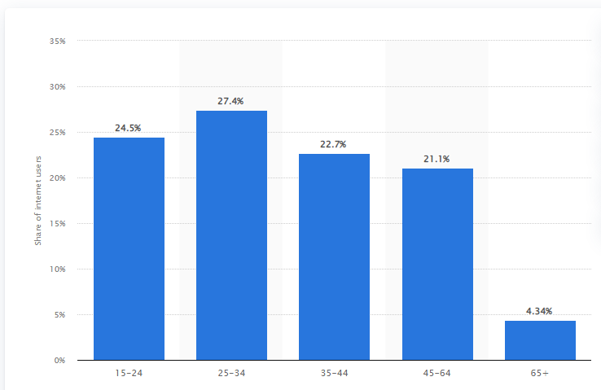
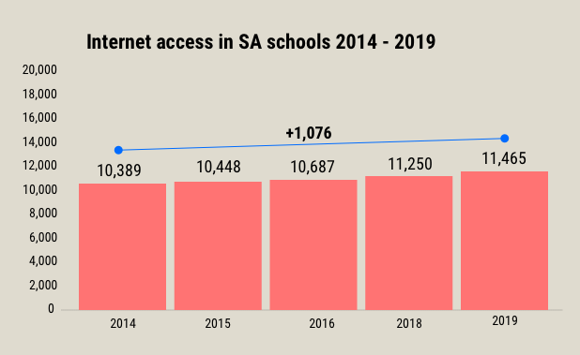
Distribution of internet users in South Africa as of 2021, by age group
https://mediahack.co.za/datastories/schools-internet/

Slide 13
Technology
The computer-driven technological revolution has brought the countries of the world closer together. In their study of the digital divide, Rodriquez and Wilson observed that all developing countries, including the poorest, are improving their access to the use of ICT.
Investment of Technology is usually in the form of :
Hardware
Software

Slide 14
Human ware (Human Capacity)
Human capacity development is a complex multifaceted endeavor consisting of many parts including :
Creating awareness of the potential for ICT to meet one’s needs
Creating, developing, and strengthening capacity to use information and ICT effectively, using local inputs
Building capacity to produce and package information so that it adds value to local inputs
Ensuring ongoing technical capacity development and developing a format for knowledge and information sharing
Preventing the local capacity from being drained to other, usually developed countries

Slide 15
Infrastructure
Infrastructure will mean fixed communication structures countries with good fixed communication structures like electricity, telephones, good roads, and airports, ICT development is a lot faster. Lack of such resources hinders the development of ICT.

Slide 16
Enabling Environments
An ICT-enabling environment is an environment in which ICT can thrive.
There are several things that can bring about such an environment:
Politics: A climate of democratic rights and civil liberties conducive to ICT adaptation .Respect for the rule of law and security of property rights. Investment in human capacity.
Public policy and Management styles: Governments must put in place streamlined regulatory policies for the importation and licensing of ICT technologies. Laws must be enacted and enforced uniformly so that nongovernmental organizations (NGOs) and other organizations interested in investing in ICT economic activities do so with ease.

Slide 17
ICT in the Workplace
The automation of the workplace has been the most vigorously pursued concept since the industrial age. Despite the original fear that workplace automation would mean the end to human work, except in a few areas, workplace automation has proceeded hand in hand with increases in employment numbers.
The Electronic Office
Office on Wheels and Wings
The Virtual Workplace

Slide 18
Categories of Telecommuters
There are three categories of telecommuters.
Consists of workers who use their homes as an adjunct to their conventional office jobs.
Consists of workers who use their homes as the base for their businesses.
Consists of those who have full-time jobs with large companies but prefer through their own initiative to work from home.

Slide 19
Effects and Benefits of Telecommuting
Gender
Nature of Work
Labor supply
Age

Slide 20
Employee Monitoring
Management is using a wide array of surveillance gadgets and techniques. These include, among others, employees taking polygraph tests if they are suspected of a breach of any kind.
Electronic monitoring is generally the monitoring of employees using electronic devices like video cameras, computer equipment, audio devices, and many other concealed gadgets. In most cases, it measures the quality and usually the quantity of work and the ability and effectiveness of the worker. In other cases, it also measures

Slide 21
Consequences of Electronic Monitoring
Electronic monitoring also causes the following problems:
Reduced task variety
Lack of individual initiatives
Reduced or no peer social support
Lack of self – esteem
Lack of interest in the job
Lack of trust among workers , between workers and supervisors and between supervisors and management

Slide 22
Workplace, Employee, Health, and Productivity
Ergonomics: Ergonomics is an applied science concerned with designing human–machine interactions that offer and maintain a safe, comfortable, healthy, and habitable work environment.
Repetitive Strain Injuries
Stress

